Slide 1

Notes:
-The Fire Equipment Manufacturers’ Association’s mission is to educate others about the importance of balanced fire protection design, which focuses on the premise that safety to life does not depend solely on any single safeguard.

Slide 2
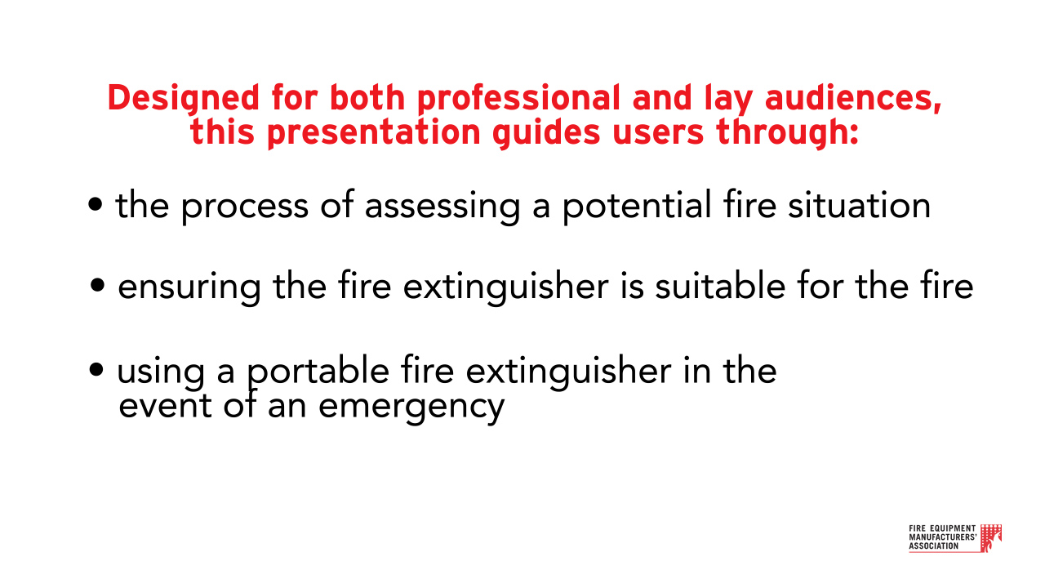
A fully illustrated video is also available here.

Slide 3
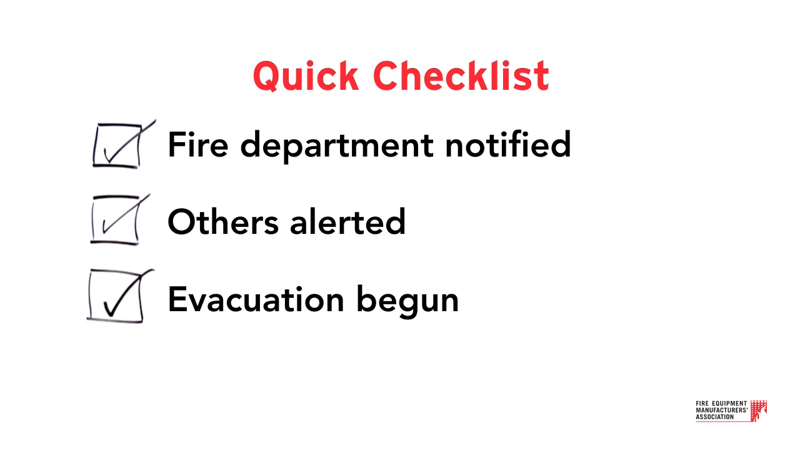
Notes:
Quick Checklist
Before using a fire extinguisher, ensure that someone:
-Notifies the fire department
-Alerts others about the fire
-Begins evacuating others from the premises
Also, confirm that the fire is small and not spreading and make sure that the fire will not block your unobstructed escape route. Only someone knowledgeable about using a fire extinguisher should operate one.

Slide 4
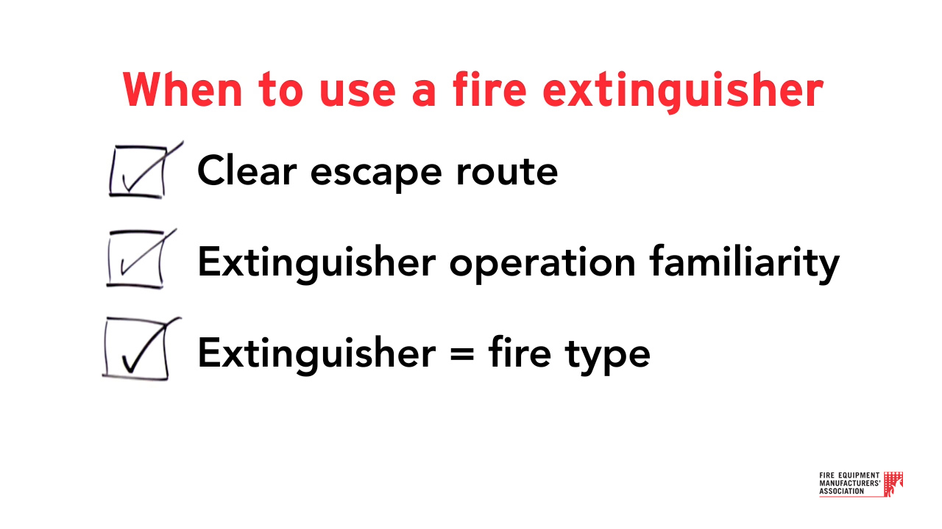
Notes:
When to use a fire extinguisher
Fire extinguishers are for controlling small fires before they have a chance to spread. Before using one, make sure that: you have a clear escape, you are familiar with the operating instructions of the fire extinguisher, and that the extinguisher you have is suitable for the fire you’re facing.

Slide 5
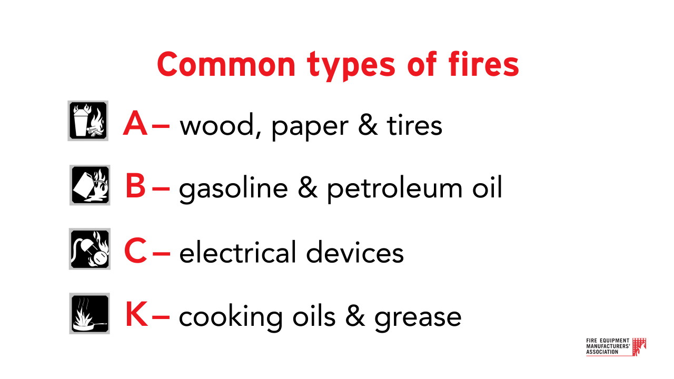
Notes:
Common types of fires
Before using an extinguisher on a fire, look at the use class symbols on the front label to make sure the extinguisher you have is suitable for the type of fire you are facing.
The most common classes of fires are A, B, C & K.
Class A fires involve common combustibles like wood, paper and tires.
Class B fires involve flammable liquids like gasoline & petroleum oil.
Class C ratings involve energized equipment or things that are plugged in, like appliances, computers, televisions and electric machinery.
Class K fires involve cooking oils and greases like vegetable fats.

Slide 6

Notes:
PASS
Once you’ve determined that the extinguisher is the correct type for the hazard, proceed to operate the extinguisher using the “P.A.S.S.” technique to control and extinguish the fire.

Slide 7
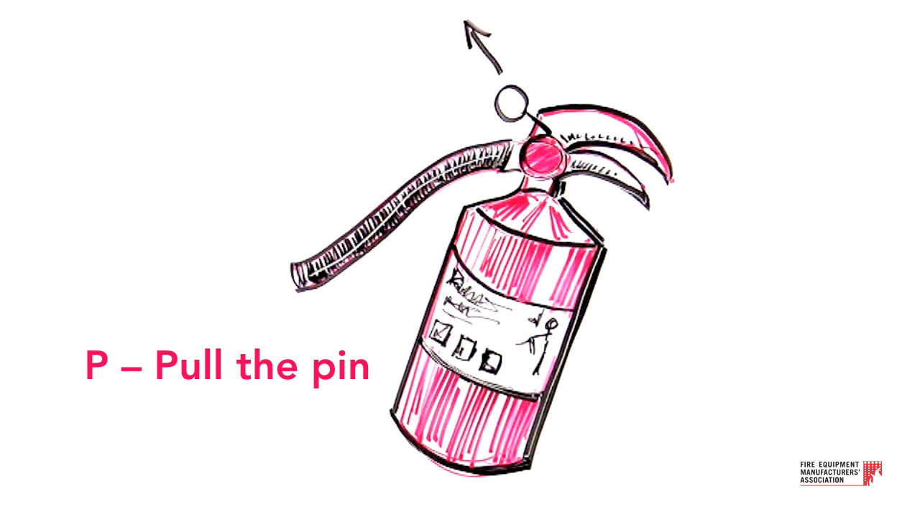
Notes:
Pull the pin

Slide 8
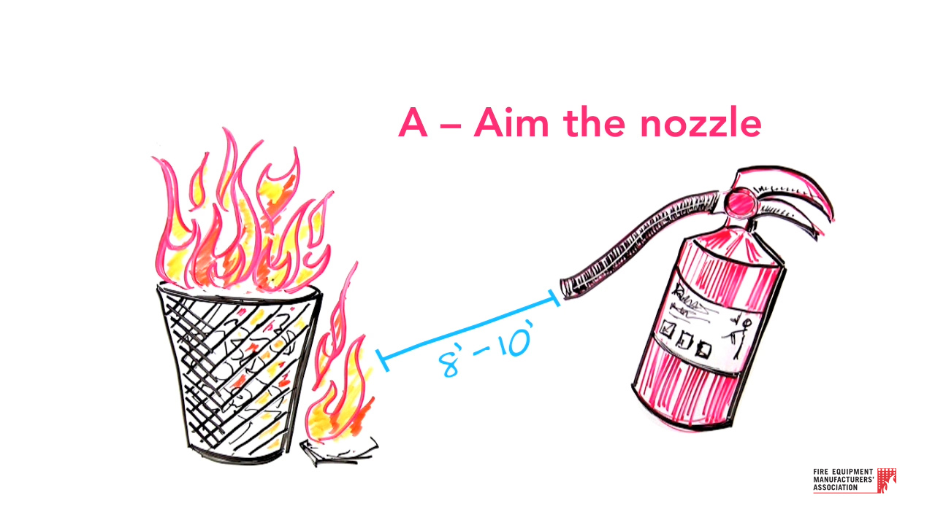
Notes:
Aim the nozzle
Next, stand 8-10 feet from the fire and aim the nozzle at the base of the fire. Do not get too close, or aim the nozzle too high.

Slide 9
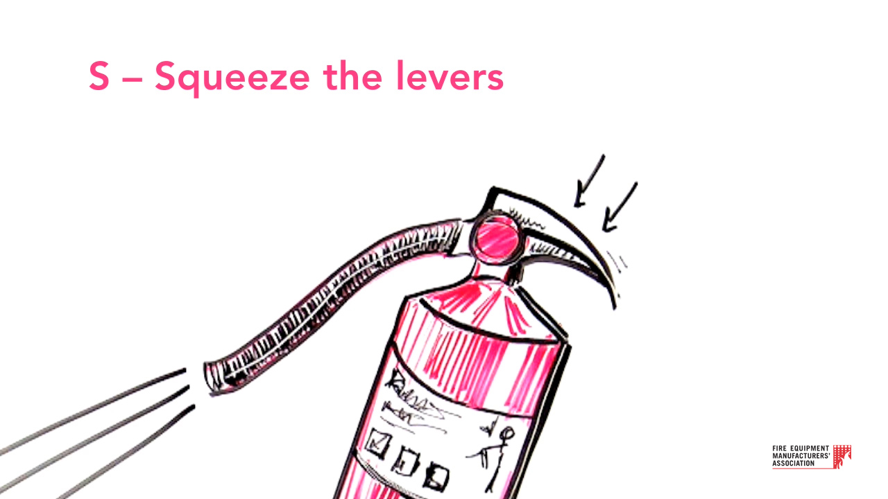
Notes:
Squeeze the levers
Once the nozzle is aimed at the base of the fire, squeeze the levers together to begin discharge of the fire extinguishing agent.

Slide 10
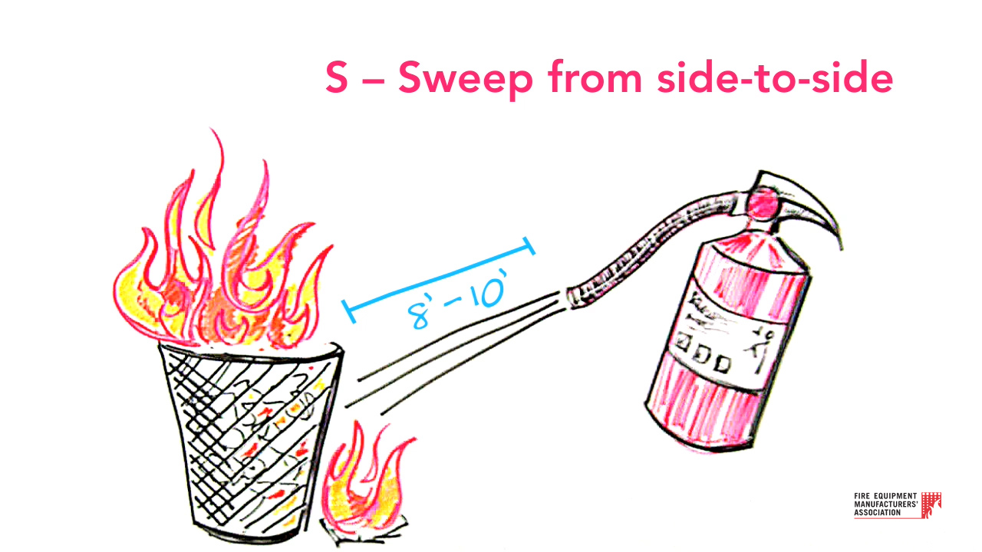
Notes:
Sweep from side-to-side
Maintain your distance from the fire and sweep the nozzle from side to side, sweeping 3 to 6 inches beyond the right and left edges of the fire. Discharge the extinguisher until contents are exhausted to prevent re-ignition. Move around the fire to confirm it is completely extinguished.

Slide 11

Notes:
Your quick action can save lives and protect property.
Using a fire extinguisher properly is only one part of a fire safety plan. For more information and training videos, go to: www.femalifesafety.org

